Slide 1
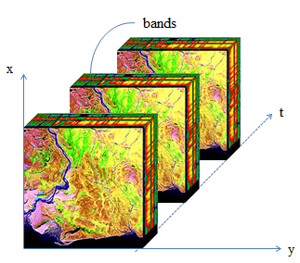
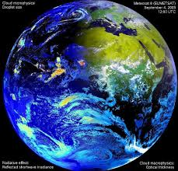
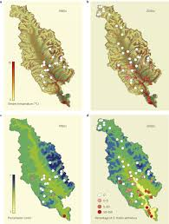
Modeling Spatio-Temporal Change from Array Data Meng Lu
Spatio-temporal Modeling Lab,
Institute for Geoinformatics,
University of Muenster, Germany
03 - 2017

Slide 2
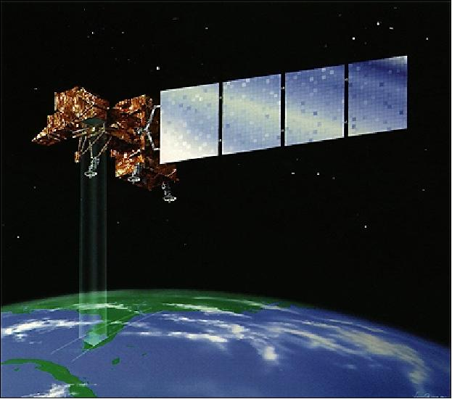
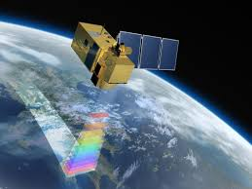

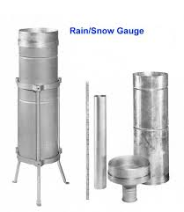
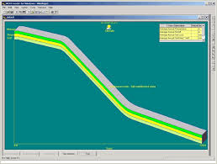
Geoscientific data: Massive, diverse, and of high dimensionality
Landsat 7
Sentinel 2
cubesat
Earth observations
in-situ measurements, model simulations, experiment outputs

Slide 3
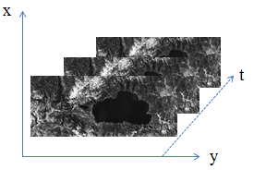
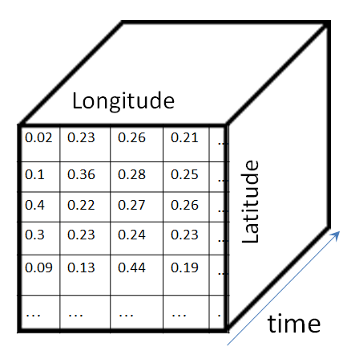
Array Structure
Definition:
An array is a set of elements which are ordered in discretized space.

Slide 4
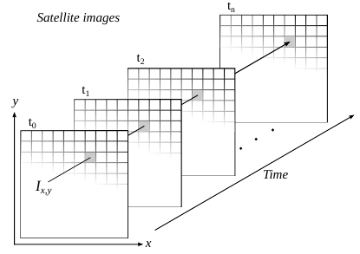
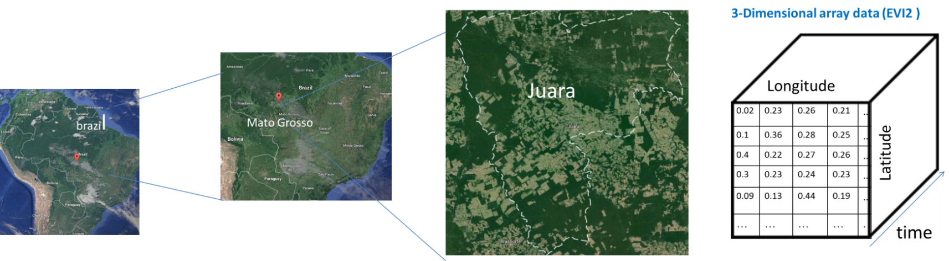
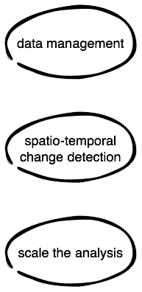

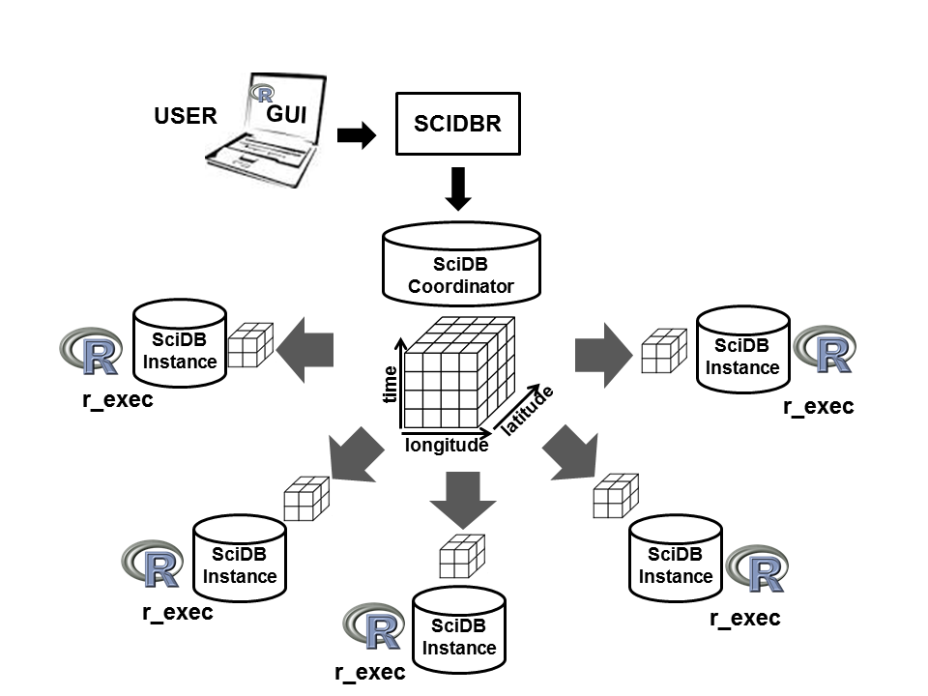
A scalable spatio-temporal change modeling process with
multi-dimensional array
3-D spatio-temporal change detection algorithm
<number>

Slide 5
Add software part here

Slide 6
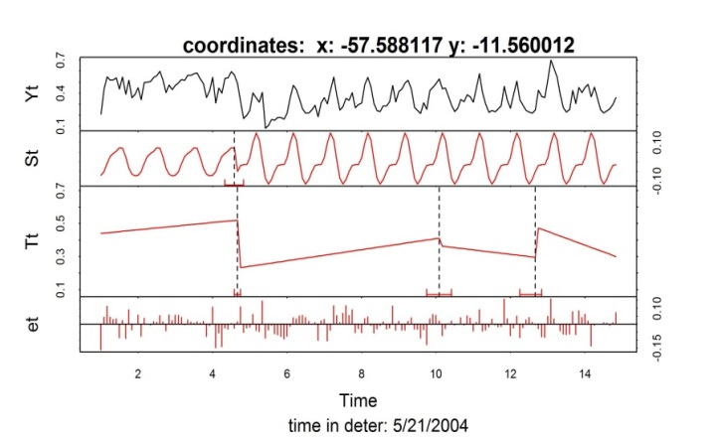
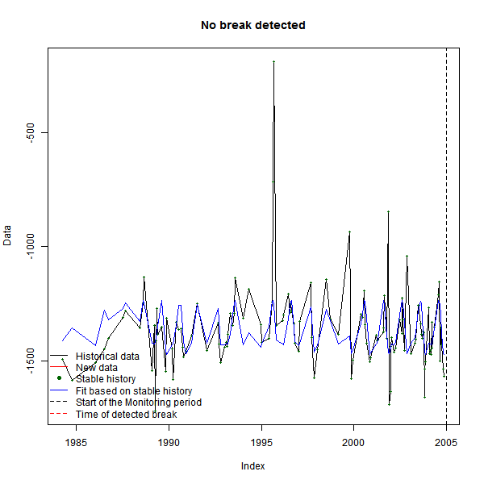
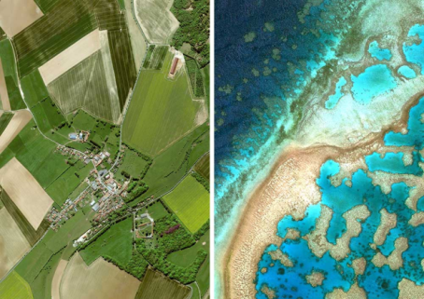
Time series structural change
Three steps:
1. constructing a vegetation index
2. pixel-wise time series analysis
3. summarise the results in space
Example:
BFAST (Breaks For Additive Season and Trend):
latitude
time
longitude

Slide 7
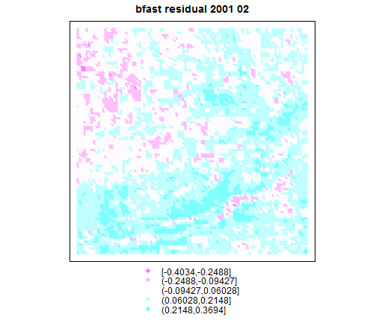
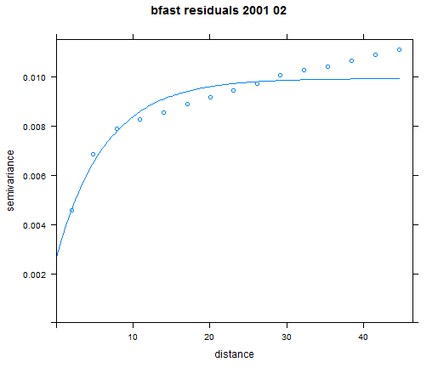
Spatial dependence
Strong spatial correlation between time series residuals
Spatial correlation of bfast residuals

Slide 8
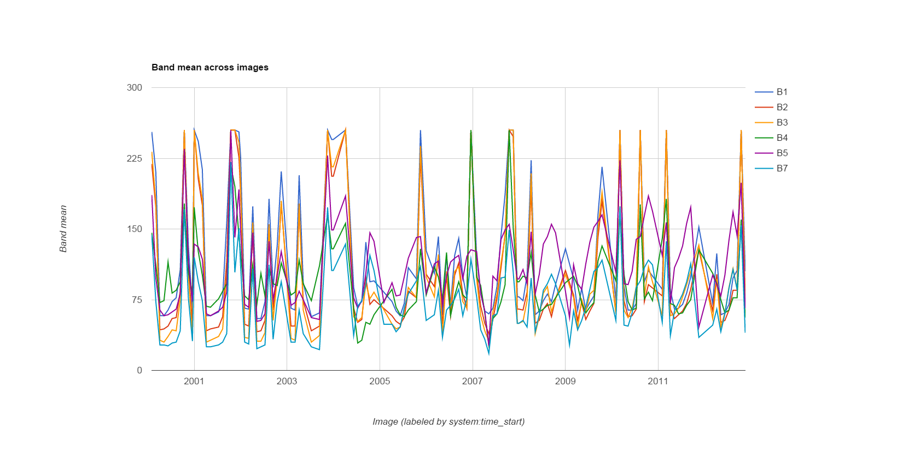
Multiple spectral bands and seasonality of a vegetation index

Slide 9

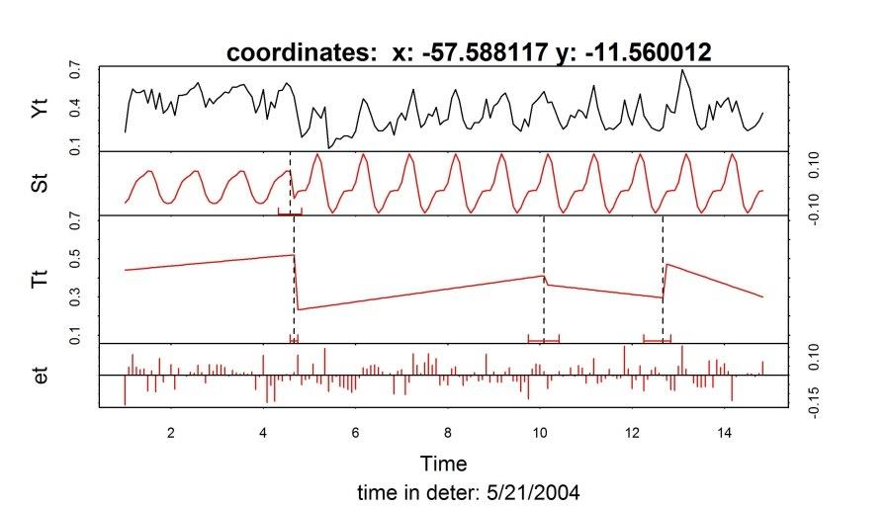
From time to space-time
<number>

Slide 10
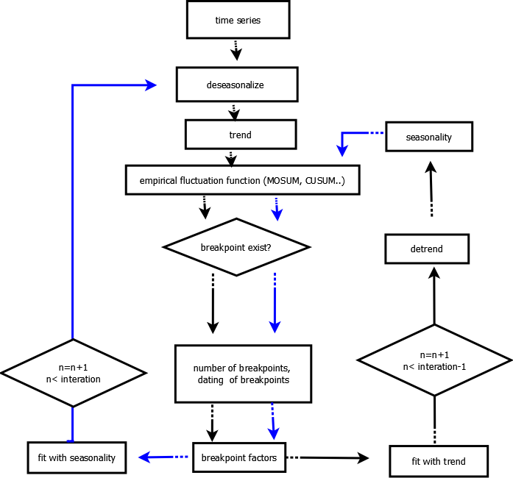
Bfast: Start
Bfast Workflow
Procedures follow the arrow of the same color
Blue: seasonality;
Black: trend
End

Slide 11
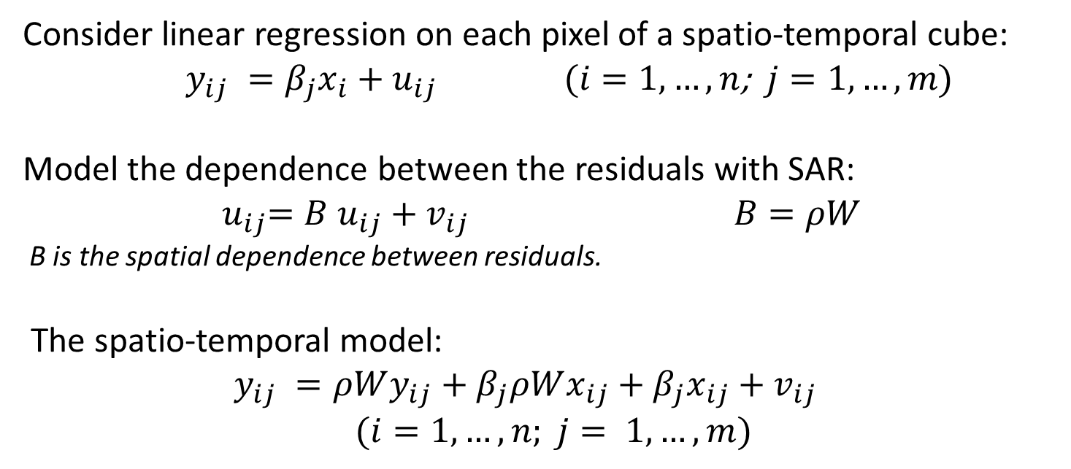
Integrate Simultaneous Autoregressive Model (SAR) in the
MOSUM/ CUSUM process of BFAST

Slide 12


Slide 13
Reference
Bai, J. & Perron, P. (2003), 'Computation and analysis of multiple structural change models', Journal of applied econometrics 18(1), 1-22
Bai, J. & Perron, P. (1998), 'Estimating and testing linear models with multiple structural changes', Econometrica, 47-78
Baumann, P. (1993), Database support for multidimensional discrete data, in David Abel & Beng Chin Ooi, ed., 'Advances in Spatial Databases', Springer Berlin Heidelberg, pp. 191-206
Baumann, P. (1999), A Database Array Algebra for Spatio-Temporal Data and Beyond, in RonY. Pinter & Shalom Tsur, ed., 'Next Generation Information Technologies and Systems', Springer Berlin Heidelberg, pp. 76-93
Baumann, P. (2009), Designing a Geo-scientific Request Language - A Database Approach, in Marianne Winslett, ed., 'Scientific and Statistical Database Management', Springer Berlin Heidelberg, pp. 56-73
Baumann, P. (1999), A database array algebra for spatio-temporal data and beyond, ed., 'Next generation information technologies and systems', Springer, pp. 76-93
Baumann, P. (1994), 'Management of multidimensional discrete data', The VLDB Journal 3(4), 401-444.

Slide 14
Reference
Killick, R.; Fearnhead, P.; & Eckley, I. A. (2012), ‘Optimal detection of changepoints with a linear computational cost’, J. Am. Statist. Assoc. 107, 1590–1598. doi:10.1080/01621459.2012.737745
Leyshock, P. (2012), ‘Agrios: A Hybrid Approach to Scalable Data Analysis Systems’, in Extremely Large Data Base Workshop, presentation.
Libkin, L.; Machlin, R. & Wong, L. (1996), ‘A Query Language for Multidimensional Arrays: Design, Implementation, and Optimization Techniques’, in Proceedings of the 1996 ACM SIGMOD International Conference on Management of Data, ACM, New York, NY, USA, pp. 228-239.
Marathe, A. P. & Salem, K. (1997), ‘A Language for Manipulating Arrays’, in Proceedings of the 23rd International Conference on Very Large Data Bases, Morgan Kaufmann Publishers Inc., San Francisco, CA, USA, pp. 46-55.
Mennis, J. (2010),’ Multidimensional Map Algebra: Design and Implementation of a Spatio‐Temporal GIS Processing Language’, Transactions in GIS, 14(1), 1-21.
Mello, M. P.; Vieira, C. A.; Rudorff, B. F.; Aplin, P.; Santos, R. D. & Aguiar, D. A. (2013), 'STARS: A new method for multitemporal remote sensing', Geoscience and Remote Sensing, IEEE Transactions on 51(4), 1897-1913.
Novotny, E. V. & Stefan, H. G. (2007), 'Stream flow in Minnesota: Indicator of climate change ', Journal of Hydrology 334, 319-333.

Slide 15
Reference
Pebesma, E. J. & Wesseling, C. G. (1998), 'Gstat: a program for geostatistical modelling, prediction and simulation', Computers & Geosciences 24(1), 17-31.
Pebesma, E. J. (2012), 'spacetime: Spatio-Temporal Data in R', Journal of Statistical Software 51(7)
Tomlin, D. C. (1990), 'Geographic information systems and cartographic modeling'
R Development Core Team (2014). ‘R: A language and environment for statistical computing’, R Foundation for Statistical Computing, Vienna, Austria. ISBN 3-900051-07-0
van Ballegooij, A. (2005), RAM: A Multidimensional Array DBMS, in Wolfgang Lindner; Marco Mesiti; Yannis Tzitzikas & AthenaI. Vakali, ed., 'Current Trends in Database Technology - EDBT 2004 Workshops', Springer Berlin Heidelberg, pp. 154-165
Verbesselt, J.; Hyndman, R.; Newnham, G. & Culvenor, D. (2010), 'Detecting trend and seasonal changes in satellite image time series', Remote sensing of Environment 114(1), 106-115.
Verbesselt, J.; Hyndman, R.; Zeileis, A. & Culvenor, D. (2010), 'Phenological change detection while accounting for abrupt and gradual trends in satellite image time series', Remote Sensing of Environment 114(12), 2970-2980.
Verbesselt, J.; Zeileis, A. & Herold, M. (2012), 'Near real-time disturbance detection using satellite image time series', Remote Sensing of Environment 123, 98-108.
Zeileis, A.; Kleiber, C.; Krammer, W. & Hornik, K. (2003), 'Testing and dating of structural changes in practice ', Computational Statistics & Data Analysis 44, 109-123.
Zeileis, A.; Leisch, F.; Hornik, K. & Kleiber, C. (2001), 'strucchange. An R package for testing for structural change in linear regression models’

Slide 16
Further Plans
More spatio-temporal modeling
Examine time series and their spatial neighbors to differentiate different types of land cover change, select different change point detection methods for different land cover types.
Represent regression parameters (i.e. seasonal and trend parameters) as spatially correlated random fields, and find break points through examining the residuals from the field.
……
Array algebra and database
Comparison between the strength and weakness of operations in SciDB; RasDaMan; Google Earth Engine in array-based spatio-temporal analyses
Expressing the spatio-temporal modeling process with MMA and extending it to a more comprehensive array algebra
Implementing spatio-temporal modeling process within the array-based DMAS.

Slide 17
Reference
Baumann, P. & Holsten, S. (2012), 'A Comparative Analysis of Array Models for Databases.', International Journal of Database Theory and Application 5(1), 89-120.
Bolin, D., Lindström, J., Eklundh, L., & Lindgren, F. (2009). 'Fast estimation of spatially dependent temporal vegetation trends using Gaussian Markov random fields. Computational Statistics & Data Analysis.' 53(8), 2885–2896. doi:10.1016/j.csda.2008.09.017
Câmara, G.; Freitas, U. M. d. & Cordeiro, J. (1994), 'Towards an algebra of geographical fields', Campinas, SP: SIBGRAPI.
Câmara, G.; Palomo, D.; de Souza, R. C. M. & de Oliveira, O. R. F. (2005), Towards a Generalized Map Algebra: Principles and Data Types, in 'GeoInfo', pp. 66-81.
Cordeiro, J. P. C.; Câmara, G.; Moura, U. F.; Barbosa, C. C. & Almeida, F. (2005), Algebraic Formalism over Maps., in 'GeoInfo', pp. 49-65.
Forkel, M.; Carvalhais, N.; Verbesselt, J.; Mahecha, M. D.; Neigh, C. S. & Reichstein, M. (2013), 'Trend Change Detection in NDVI Time Series: Effects of Inter-Annual Variability and Methodology', Remote Sensing 5(5), 2113-2144.
Frank, A. (2005), Map Algebra Extended with Functors for Temporal Data, in Jacky Akoka; StephenW. Liddle; Il-Yeol Song; Michela Bertolotto; Isabelle Comyn-Wattiau; Willem-Jan van den Heuvel; Manuel Kolp; Juan Trujillo; Christian Kop & HeinrichC. Mayr, ed., 'Perspectives in Conceptual Modeling', Springer Berlin Heidelberg, pp. 194-207.
Goodrich, D. C.; Fauras, J.M.; Woolhiser, D. A.; Lane, L. J. & Sorooshian, S. (1995), 'Measurement and analysis of small-scale convective storm rainfall variability ', Journal of Hydrology 173, 283-308.
Jiang, Z., Huete, A. R., Didan, K. & Miura T. (2008). ‘Development of a two-band Enhanced Vegetation Index without a blue band’, Remote Sensing of Environment, 112(10), 3833-3845.
Jong, R.; Verbesselt, J.; Schapman, M. E. & Bruin, S. (2012), 'Trend changes in global greening and browning: contribution of short-term trends to longer-term change', Global Change Biology 18(2), 642-655.
Killick, R.; & Eckley, I. A. (2014), ‘ Changepoint: an R package for changepoint analysis’, Journal of Statistical Software, 58 (3), pp. 1-19.

Slide 18
Bringing in change information from neighboring pixels
8 spatial neighbors
for a pixel, if p-value > 0.05 and p-value < 0.1,
and if average(Neighbors p-value) < 0.1, accept the pixel
0.08 | 0.06 | 0.07
0.07 | 0.06 | 0.09
0.06 | 0.05 | 0.01
150 by 150 | Filtered points | Bfast detected change
Trend | 1456 | 657

Slide 19
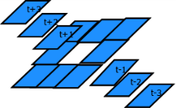
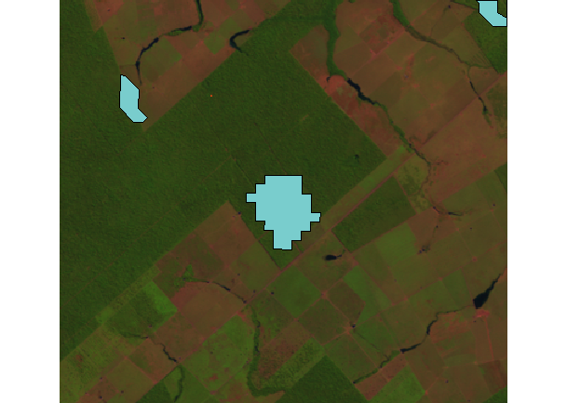
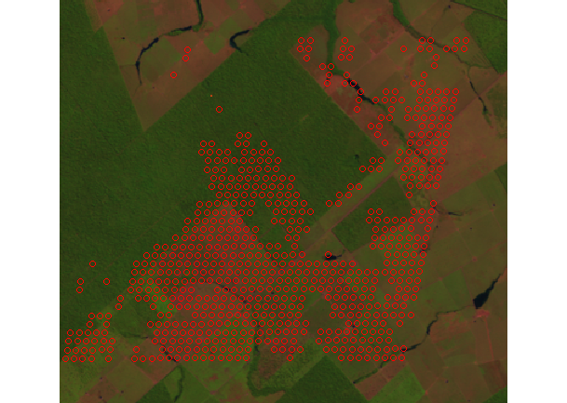
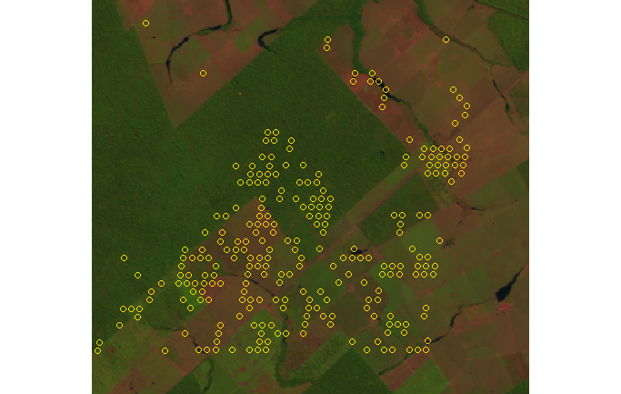
Spatio-temporal Kriging
Different spatio-temporal neighbors for Kriging
Compare the observations with distribution of Kriging estimations
Mean = Kriging prediction
Variance =Kriging variance
Significance of p-value
0.2, 0.1; 0.05…
changes detected in DETER, BFAST and Kriging
Deter change
Bfast change
691 spatial points
Kriging change
p-value=0.1, filtered
256 spatial points
1885 spatio-temporal points

Slide 20
Methodology
Develop a spatio-temporal change detection model
Store the data and statistical into multidimensional array
Change point detection in time series
Put the result in spatio-temporal cube
Bring in and filter out change points by observing the spatio-temporal neighbors of the point.
Develop joined spatio-temporal models to integrate spatial context into time series analyses.
Extend the current array-based database management and analytics software (DMAS) to fit into spatio-temporal change detection.
Implement the spatio-temporal statistical models in SciDB using AFL or AQL; in Rasdaman using RaSQL; and in the R interface of SciDB. Compare the efficiency of these implementations in different systems.
Express the spatio-temporal statistical models of different level of complexities in Multidimensional Map Algebra.
Extend the data structure and operators of Multidimensional Map Algebra to higher dimensionality and integrate the extended Multidimensional Map Algebra within array databases.

Slide 21
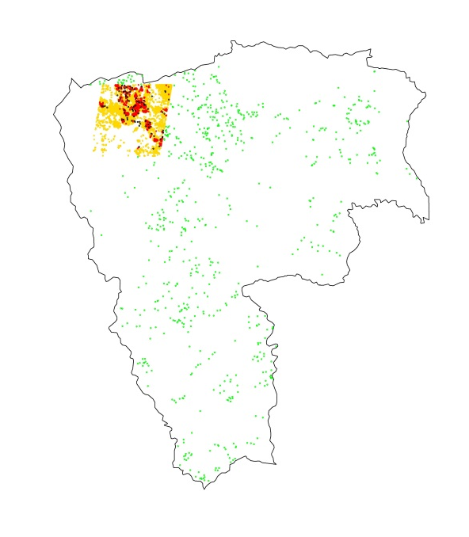
Data and Process
Vegetation index: EVI2 (enhanced vegetation index)
Testing array 150 by 150 pixels
Smaller testing array: 40 by 42 pixels
t
Change point detection method: bfast
Amazonian forest monitoring systems from Brazilian National Institute for Space Research
System | Report frequency | Function | Sensor | Resolution
DETER | half-monthly | forest degradation | MODIS | 250m
PRODES | Yearly | forest clear cutting | Landsat 5 | 30m
DEGRAD | Yearly | forest degradation | Landsat 5 | 30m

Slide 22

Study case 2 : Land cover change detection with historical MODIS satellite data
Study site: Juara, Mato Grosso, Brazil
852*948*634 (t)
MODIS images -> dense three dimensional spatio-temporal array in SciDB
The spatial coordinates and temporal information can be retrieved from the array index.
Data Description:
MOD09Q1
250 mts spatial resolution
8 days temporal resolution
4800 x 4800 pixels
3 bands (red, nir, qc)
13 years of data (since 2000)
HDF format tiles
Data in SciDB:
No name start length chunk_interval chunk_overlap low high type
1 col_id 58828 852 502 5 58828 59679 int64
2 row_id 48103 948 502 5 48103 49050 int64
3 time_id 0 9201 1 0 6 643 int64

Slide 23
Bfast: Start
Bfast Workflow
Procedures follow the arrow of the same color
Blue: seasonality;
Black: trend
End

Slide 24
Examples of Array Data
An important portion of earth system observations and simulated data can be represented as multidimensional array data
1-D: time series
2-D: satellite images
3-D: satellite image time series; multi-spectral data; subsurface hydrological data
4-D: hyper-spectral remote sensing time series data
5-D: different sensors, sensor bands, spatial coordinates, and time (sensors /bands/x/y/t).
n-D …
value
time

Slide 25
Methodology
Develop a spatio-temporal change detection model
Time series analyses per pixel
Select appropriate change point detection method based on situations
Change point detection
Spatio-temporal Filter
Joined spatio-temporal statistical model
Integrate spatial information
Spatio-temporal change detection model
scale the change detection model
Extend the data analytic power of array-based DMAS to fit into spatio-temporal change modeling
Express the spatio-temporal model MMA
Extend the operator and data structure of MMA
Implement the spatio-temporal models within SciDB with extended MMA
Implement extended MMA in SciDB
Other change detection methods
Information integration
MMA: Multidimensional Map Algebra

Slide 26
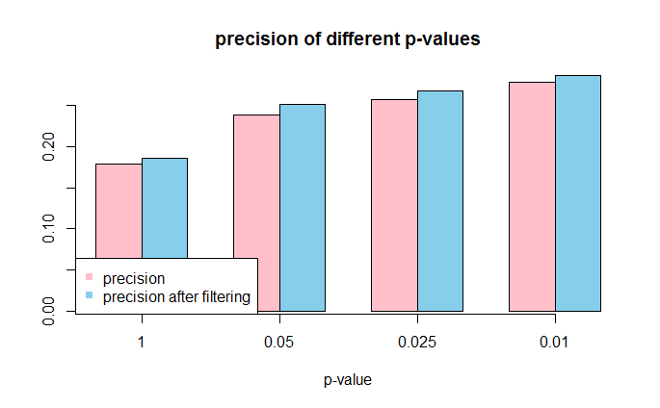
Precision with different significance level in empirical process (MOSUM)
Precision (producer’s accuracy)
TP /(TP+FP)
Represents how well reference pixels of the ground cover type are classified
TP : True Positive
FP: False Positive

Slide 27

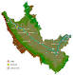
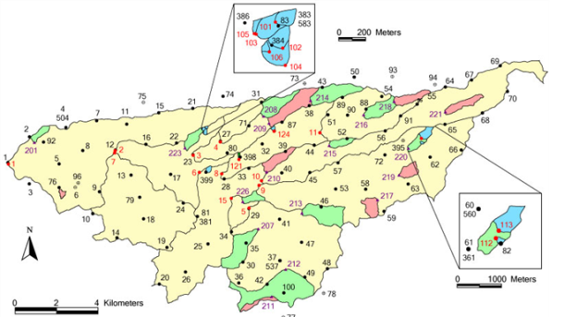
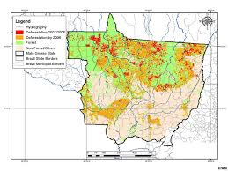
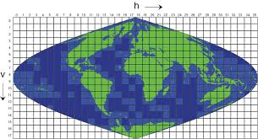
Study cases
Spatio-temporal Rainfall Pattern
Study site:
Walnut Gulch Experimental Watershed, Arizona, USA
Minnesota River Basin, USA
Description:
Semi-arid watershed with dense rainfall gauge network, 50-year records
Entire river basin with sparse rainfall gauge network, 100-year records
Data:
Rainfall gauge data with regular and irregular time series
Land Cover Change
Study site:
Juara, Mato Grosso, Brazil
Description:
Under drastic land cover change, 13-year historical image archive
Data:
MODIS Remote Sensing satellite images

Slide 28
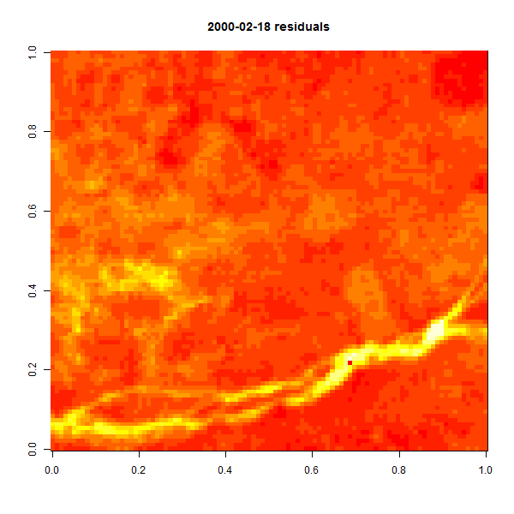
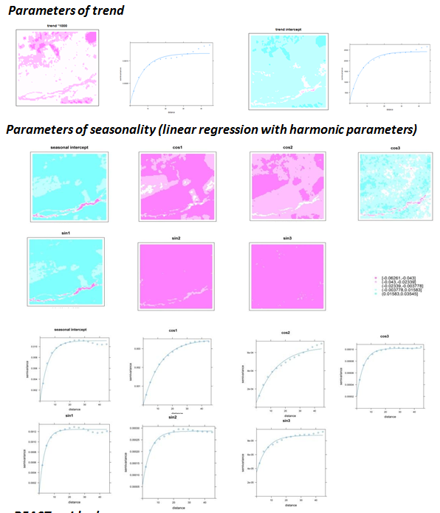
Spatial pattern of bfast residuals and bfast parameters
Spatial correlation of bfast parameters
Spatial correlation of bfast residuals
Strong spatial correlation in bfast residuals and bfast parameters

Slide 29
y= Bx + C
Y2=b2x +C2
y=acosa +bsina +ccos2a+dsin2a+ecos4a+fsin4a+g

Slide 30


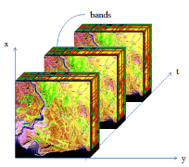
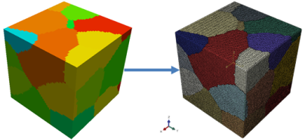
Potential of Array Data in Change Modeling
Close in space and time
Data integration and information extraction:
Spatio-temporal statistical analysis
Multi-temporal, multi-spectral analyses
Integrate data from different sensors and resolutions
Flexible algorithm application:
Algorithm at any location, within any partition, on different dimensions and on different directions (i.e. different combination of dimensions).
Parallel computation:
Processing satellite time series analysis in a parallel regional-wise computation.

Slide 31
SciDB Array
Build(< A: integer NULLS, B: double> [I=0:6,4, 1, J=0:6,4, 1 ])
attribute names
index names
chunk size
overlap
Overlap
Chunk
Notes:
AQL deals with ARRAYS, not TABLES.
In this case, the Test_Array is 100K x 100K in size, and is divided into 10,000 "chunks" - each of which is 1Kx1K in size.
In AQL, attributes are NOT NULL by default
the SciDB NULL handling is very different to SQL. (no 3VL)
We will support user defined attribute types
The "index" elements define both the logical properties of the array (it's size) and the way the array is organized "physically"
We will support a variety of physical distribution schemes over the compute nodes that make up a SciDB instance (next release)

Slide 32
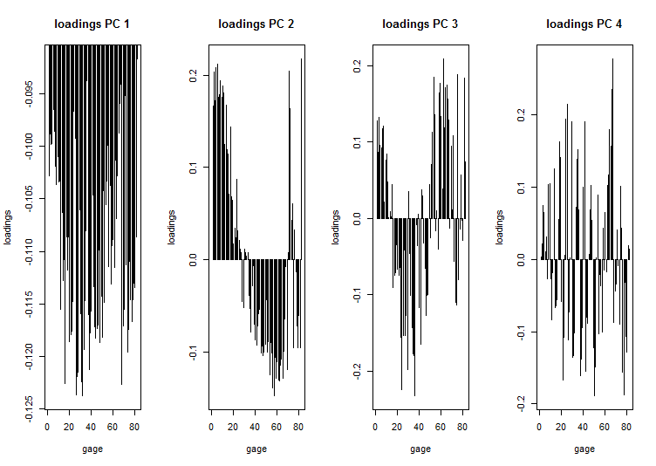
SciDB-R Interface
Rainfall gages network : 82 gages, 30 years of precipitation
Array construction
iquery(‘create array p_Wdt1<preamount:double> [ Gn1=1:82,82,0, timeint=1:30,30,0]’)
Average on column (Gage as variable), standard deviation on column
iquery('store(aggregate(p_Wdt1,avg(preamount),Gn1), p_Wave)‘)
iquery('store(aggregate(p_Wdt1,stdev(preamount),Gn1), p_variance)')
Cross join the mean to the array
iquery("store(cross_join(p_Wdt1,p_Wave,p_Wdt1.Gn1,p_Wave.Gn1),pjoin)")
iquery("store(cross_join(pjoin,p_variance,pjoin.Gn1,p_variance.Gn1),pjoin2)")
Center the data by subtracting the average, scale the data by dividing the standard deviation
iquery("store(apply(pjoin2,censcale,(preamount-preamount_avg)/preamount_var),censcal) ")
iquery('store(subarray(p_Wdt1,1,1,82,30),new1)') -- bring array to start from (0,0)
Bring back to R
a2<-scidb('new1')
a3<-svd(a2)
plot(a3$v[][,1],typ='h',main=paste('loadings PC',i),
ylab='loadings',xlab='year')
In R:
fit=prcomp( array, center=TRUE, scale.=TRUE)

Slide 33
Investigate the feasibility of using array data in large-scale spatio-temporal change modeling
Develop a spatio-temporal change detection model
Use the array-based DMAS to model large-scale spatio-temporal change

